Slide 1


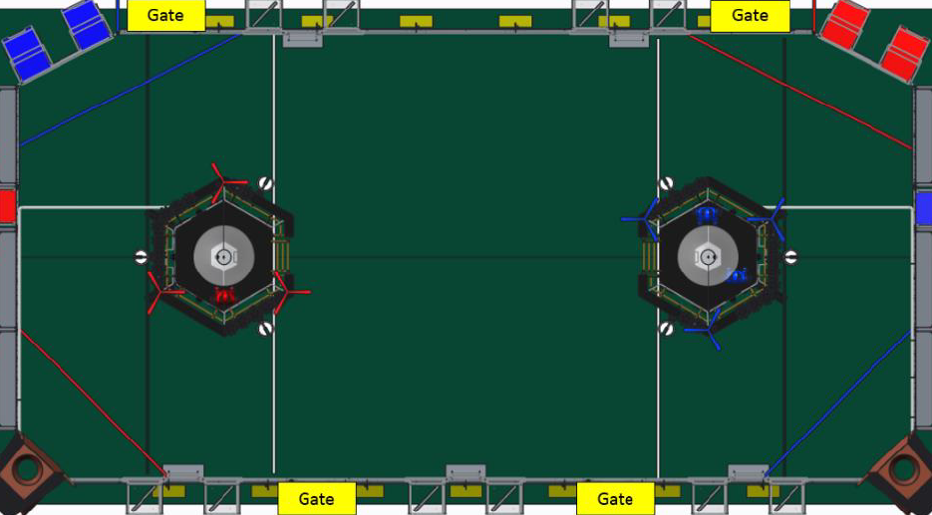
CLIMB
Fuel Acquire
Dump
Dump
Gear
Acquire
MISC.
A
Gear
Placed
B
PATH
A
PATH
B
C
Fuel
Shot
PATH
C
Dump
Dump
Dump
Notes:
This is the first page that shows up after they submit their autonomous data. It can lead to the gear score page, the fuel score page, the climb page, or the misc. page. When they click “gear acquire, the paths and path buttons show up to allow the scout to chose the path. Once the path is chosen, the other two paths and their buttons disappear. Once the scout goes the the “gear placed” page and picks a location, the paths all disappear until they pick up another gear. Depending on the alliance color, the ‘gear placed,’ ‘fuel shot,’ ‘fuel acquire’ and ‘gear acquire’ buttons will switch sides. Also, the paths that show up will be from the correct feeder stations to the correct towers.

Slide 2
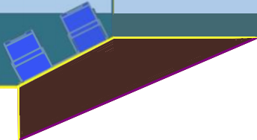
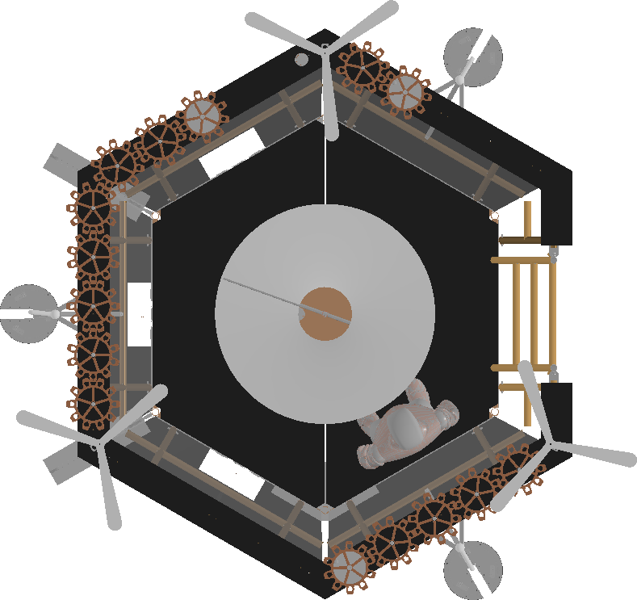

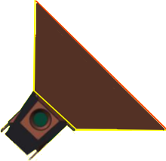
Placed Here
Placed Here
Gear Dropped
Placed Here
Notes:
“Gear Placed” page. Depending on alliance, the airship flips to the other side along with the buttons, the boiler, and feeder station. Once the “placed here” or “gear dropped” buttons are pressed, the gear cycle (which includes total time, place location, dropped, and path taken) object is saved and it automatically goes back to the main teleop page. The faint outline of the tower wont be on the actual picture.

Slide 3
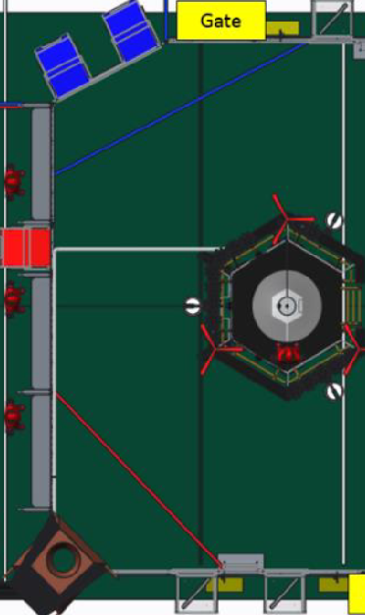
High Scores:
+10
+5
+1
0
-5
-1
High Misses:
+10
+5
+1
0
-5
-1
Low Scores:
+10
+5
+1
0
-5
-1
Shot
Location
Back to Main
Notes:
“Fuel Shot” page. They drag-and-drop a “shot location” icon to roughly estimate where they shoot from, and the center of the icon is stored through a grid system. If they do a low-goal dump, their location is right by the boiler. Each time they come to this page, the counters are at ‘0’ so that we can have accuracy data for different locations to see where they are the most accurate. The field image and the other half would switch sides depending on the alliance. The “back to main” button takes you back to the main page once the robot stops shooting.

Slide 4
Dead Bot:
✓
Played Defense:
✓
Yellow Card:
✓
Red Card:
✓
Fouls:
+25
+5
0
-25
-5
Back to Main
Submit
Notes:
Miscellaneous page. Boxes are checked if the bot ever died, even if it wakes back up. If the robot ever played defense (more than a push before resuming to score) they check that box, too. If yellow/red cards are announced, those boxes are checked. If it can be determined that they were charged with fouls, 25 points are added for a tech foul and 5 points are added for regular fouls that this team committed.

Slide 5
Start
Climb
Start
Climb
Finished
Climb
Climb Success:
✓
Back to Main
Start
Climb
Notes:
When they come to this page, they hit “start climb” (one of the three, based on position) when the robot starts to climb. It starts a timer which ends when the light at the top of the climb rope lights up and the scout hits the “climb finished” button. At the end of the match, they can come back and check “climb success” once it is sure that they got the points. They check the “free climb” box if they were fouled and awarded a free climb.

